Slide 1

Data Analysis
Mihir Chikani

Slide 2


Table of contents
Project Overview
Data Collection
Various Data Analysis
Conclusion

Slide 3


Project Overview
Intro
Data Source
Data Analysis
Conclusion

Slide 4
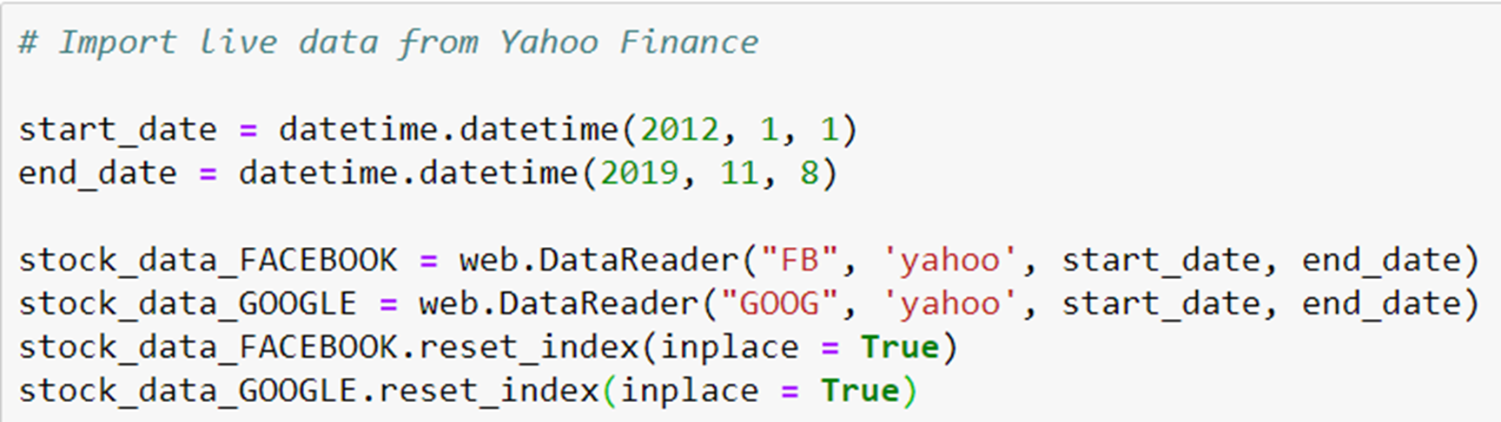
Jupyter notebook code sample

Slide 5

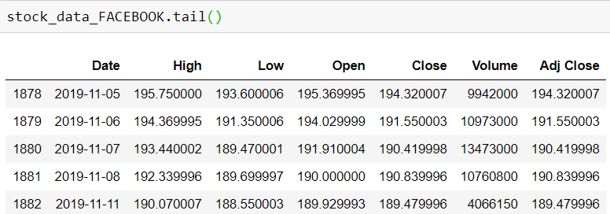
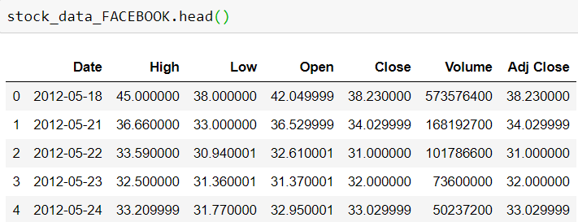
Preview of the data
recent stock value
Oldest stock value
Total Rows: 1,878
Starting Date: 05/18/12

Slide 6

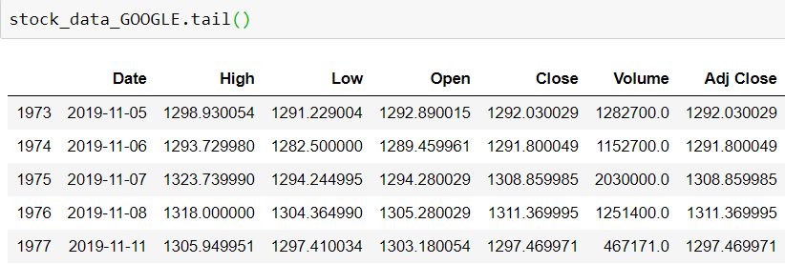
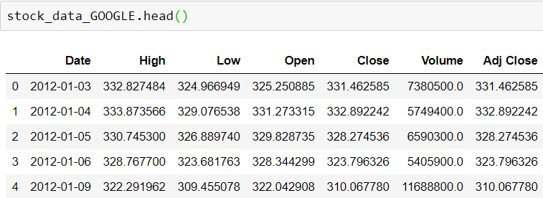
Preview of the data
recent stock value
Oldest stock value
Total Rows: 1,973
Starting Date: 01/03/12

Slide 7

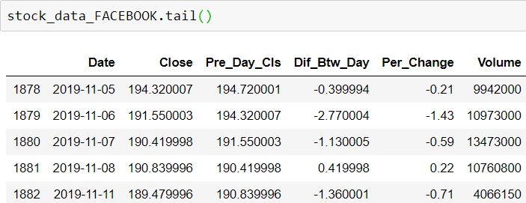
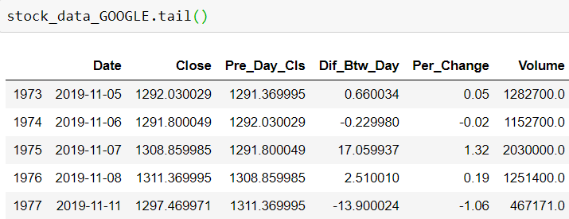
Data clean-up, New columns addition & column rearrangement
Updated data-set
Updated data-Set

Slide 8
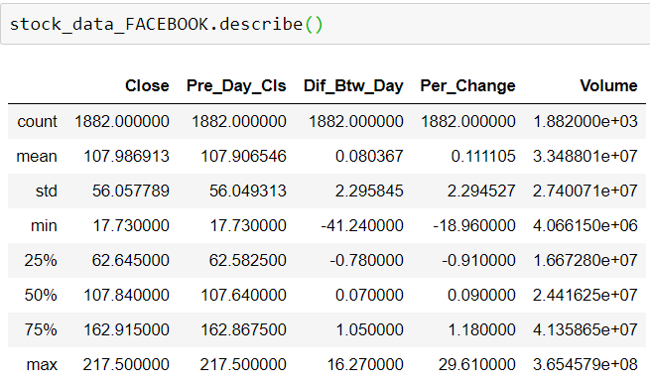
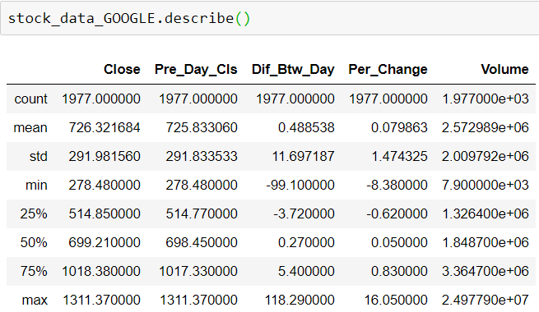
Data overview

Slide 9
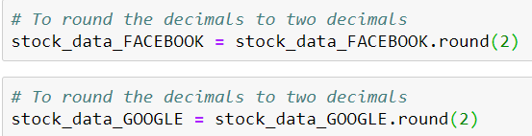
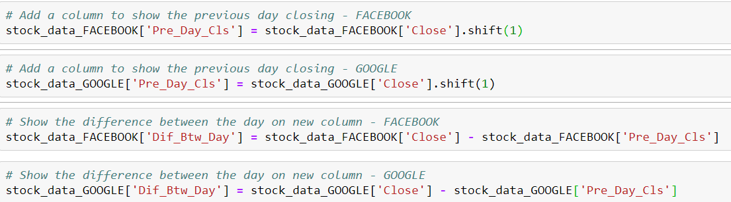
Jupyter notebook code sample

Slide 10
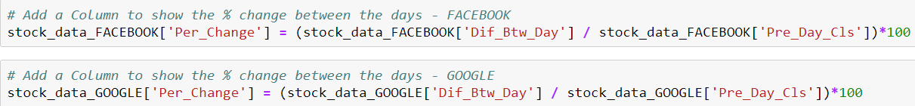
Jupyter notebook code sample

Slide 11
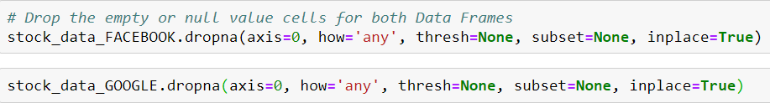
Jupyter notebook code sample

Slide 12
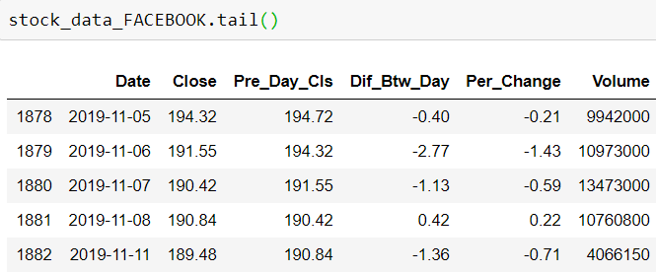
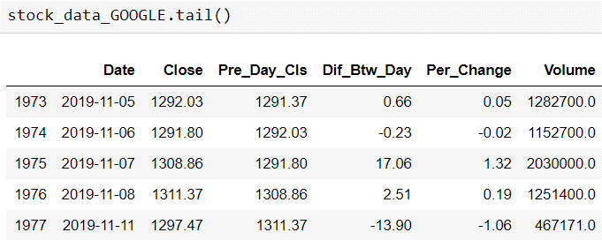
Final product of data

Slide 13
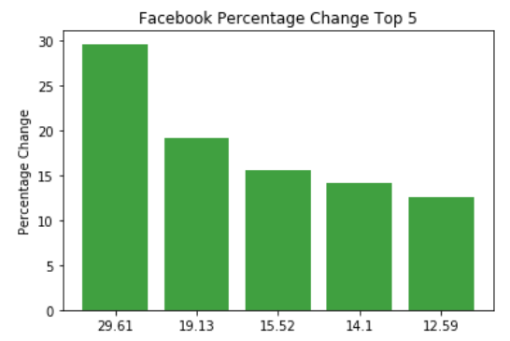
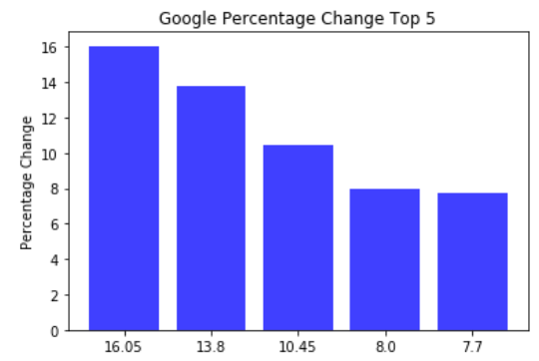
percentage change – Top 5

Slide 14
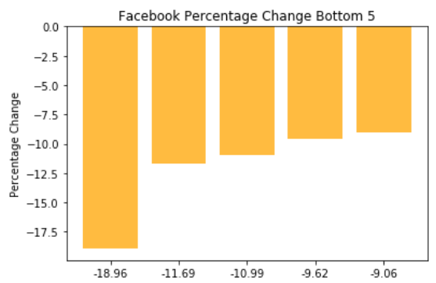
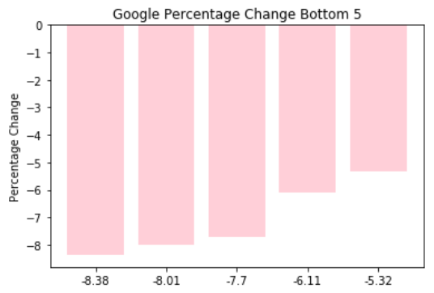
percentage change – Bottom 5

Slide 15
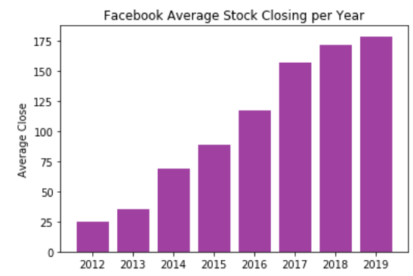
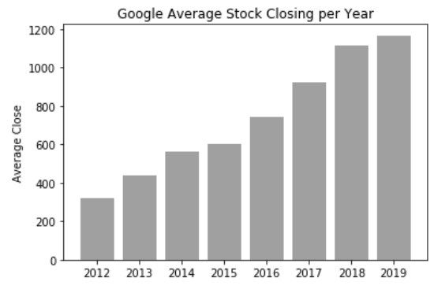
Average Stock Closing per year

Slide 16
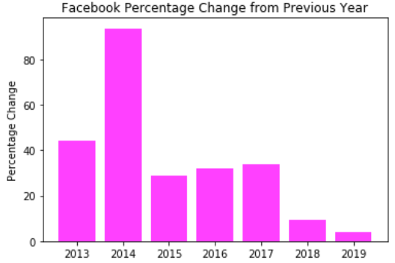
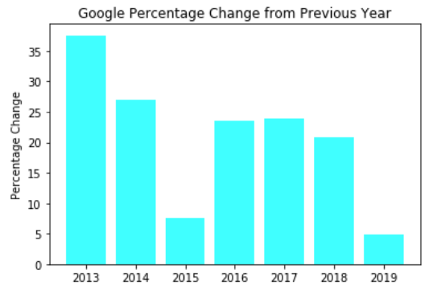
% Change from previous year

Slide 17
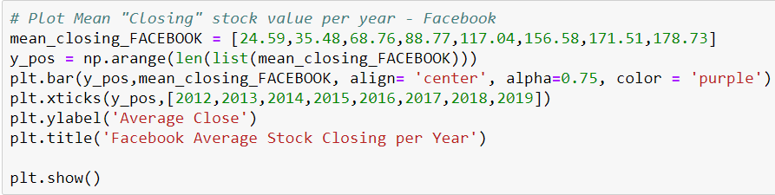
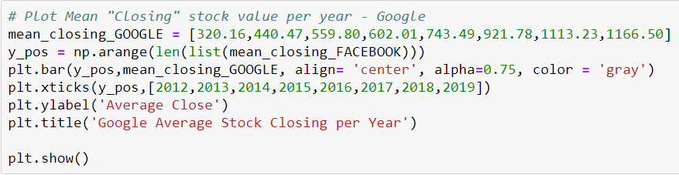
Jupyter notebook code sample

Slide 18
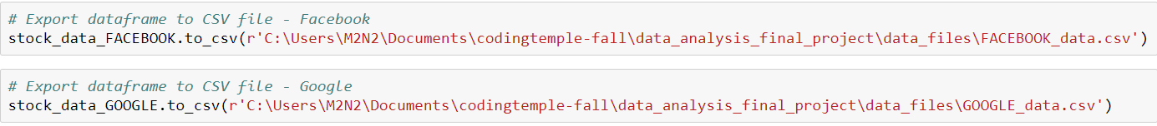
Data export
data_files\FACEBOOK_data.csv
data_files\GOOGLE_data.csv

Slide 19
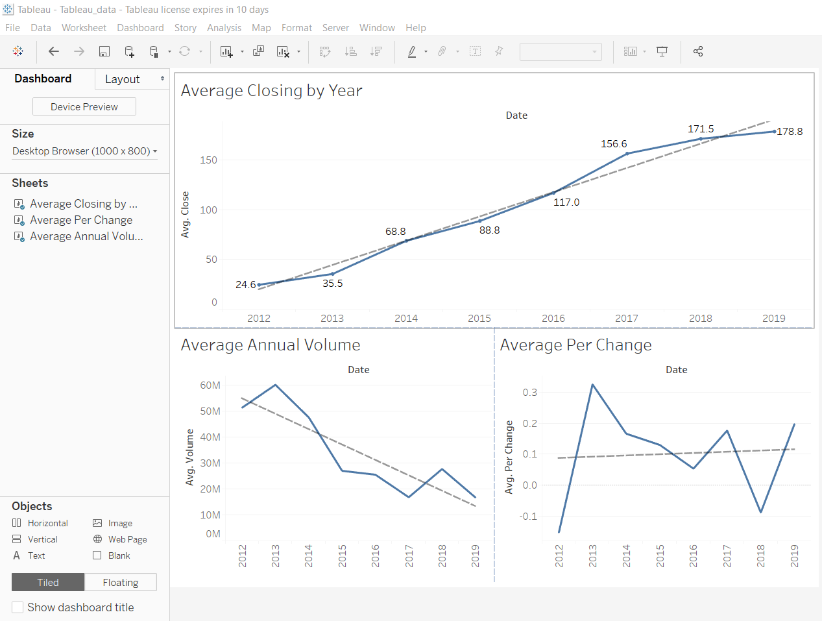
Data visualization - tableau

Slide 20
Key Events in company history
Feb 2014 WhatsApp purchase
Apr 2016 On of the biggest single day stock increase (9%)
Jul 2018 $119 Billion in Market Cap lost Stock dropped 19%
Oct 2018 Security breach 30 million users affected
July 2019 $5 Billion settlement with FTC
2012 Revenue crossed $50 Billion
2014 Stock Split to create non-voting shares
2015 Restructured as Alphabet
2017 European Regulators fines $2.7 Billion
Feb 2018 $41 Billion in Market Cap lost

Slide 21

Conclusion
Data Analyzed
&
Avg. Percentage Increase
35.23%
20.75%
Timeframe
2012-2019
2020 Projected Value
$241.70
$1,401.30
Annual Avg Stock Value

Slide 22


